Slide 1
Loan Approval Prediction using Machine Learning
By Lindokuhle Lufele

Slide 2
Loans are an essential aspect of modern life, enabling individuals to achieve their financial goals, whether it's pursuing higher education, buying a dream home, or acquiring luxury items. Banks and financial institutions rely heavily on loan disbursements to generate a significant portion of their profits. Effective loan management is crucial to ensure that borrowers can repay their debts, and lenders can minimize risks and maximize returns.
A machine learning loan prediction model is a powerful tool used to predict the likelihood of a borrower repaying a loan. This model leverages historical data, machine learning algorithms , and statistical techniques to identify patterns and trends that can inform lending decisions.
Objectives
The primary objective of this model is to accurately predict loan approvals and minimize the risk of default. By doing so, lenders can:
Improve Credit Risk Assessment: Identify high-risk borrowers and make informed lending decisions.
Reduce Default Rates: Minimize financial losses associated with loan defaults.
Enhance Customer Experience: Provide faster and more accurate loan approvals to borrowers.

Slide 3
Methodology
The model employs a combination of machine learning algorithms, including:
Logistic Regression: A statistical method used to predict the probability of a binary outcome (loan approval or rejection).
Decision Trees: A tree-based model used to identify patterns and relationships in data.
Random Forest: An ensemble learning method that combines multiple decision trees to improve prediction accuracy.
Support Vector Machines (SVM): A machine learning algorithm used to classify data and predict outcomes.
Data Preprocessing
The model utilizes a dataset containing 13 features, including:
Name | Data Type
Applicant Income | vchar
Co-Applicant Income | vchar
Loan Amount | int
Loan Term | int
Credit History | date
Property Area | vchar
Marital Status | vchar
Education | vchar
Self-Employed | vchar
Dependents | int
Gender | vchar

Slide 4
Exploratory Data analysis
The data is preprocessed to handle missing values, outliers, and duplicates. Feature selection techniques are also employed to identify the most relevant features that impact loan approval decisions.
Model Evaluation
Model | Best Parameters | Accuracy Score (%)
RandomForest | {'max_depth': None, 'min_samples_split': 2, 'n_estimators': 100} | 100.00%
KNeighbors | {'n_neighbors': 9, 'weights': 'distance'} | 100.00%
SVC | {'C': 10, 'kernel': 'linear'} | 97.00%
LogisticRegression | {'C': 1, 'solver': 'saga'} | 100.00%
Random Forest and K Neighbors achieve perfect accuracy: Both models demonstrate exceptional performance, achieving an accuracy score of 100.00% on the testing set. This suggests that these models are highly effective in predicting loan approvals.
SVC performs well, but not as well as Random Forest and K Neighbors: The SVC model achieves an accuracy score of 97.00%, which is still a respectable performance. However, it lags behind the top-performing models.
Logistic Regression is a strong contender: With an accuracy score of 100.00%, Logistic Regression is a strong contender for loan prediction. Its performance is on par with Random Forest and K Neighbors.

Slide 5




Project Tools
- for data manipulation and analysis
- for numerical computations
- for visualization
- for visualization

Slide 6
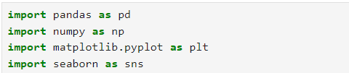

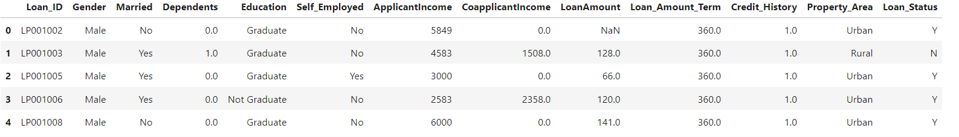
Loan Code
Importing Libraries and Dataset
Upload the data set that will be used for analysis
Output :

Slide 7

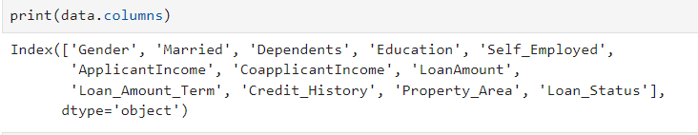
Data Preprocessing and Visualization
Get the number of columns of object datatype
As Loan_ID is completely unique and not correlated with any of the other column, So we will drop it using .drop() function.
Check if Loan_ID have been removed

Slide 8
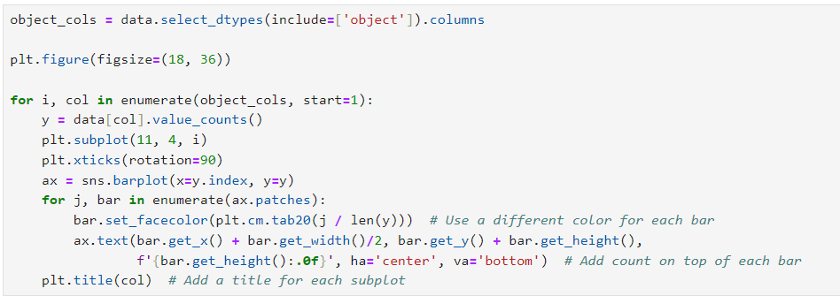
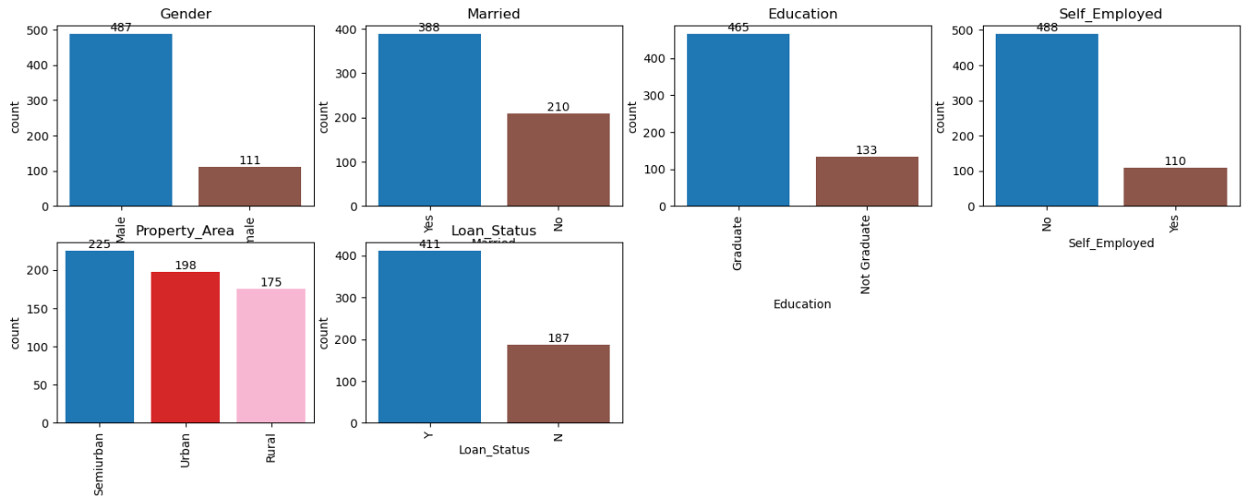
To visualize all the unique values in the columns, we can use a bar plot. This will clearly show which values dominate in the dataset.
By visualizing the categorical columns, we gain key insights into the distribution of data. The bar plots show the frequency of each unique value, helping us understand how the data is spread across different categories. This can highlight potential imbalances or dominant categories that might impact the analysis.

Slide 9
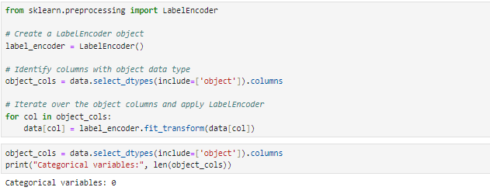
Since all the categorical values are binary, we can use Label Encoder for these columns, converting the values into integers.

Slide 10
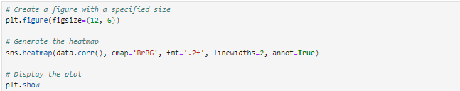
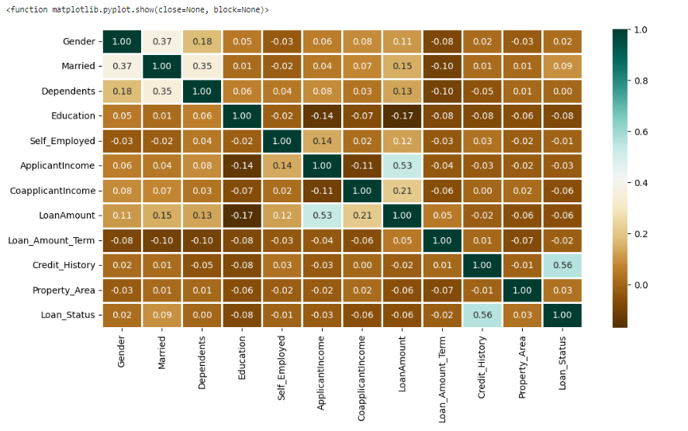
The heatmap above shows the correlation between Loan Amount and Applicant Income. It also highlights that Credit History has a significant impact on Loan Status.
Output

Slide 11
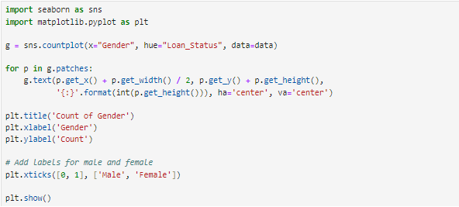
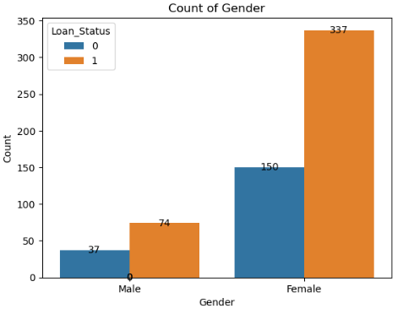
I used Catplot to visualize the plot for the Gender, and Marital Status of the applicant.
Output
This plot helps us understand the relationship between gender and loan status. By using a count plot, we can easily see how many males and females applied for loans and how many of them had their loans approved or rejected.

Slide 12
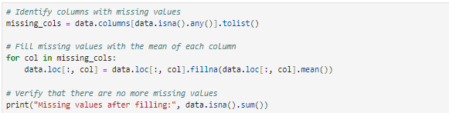
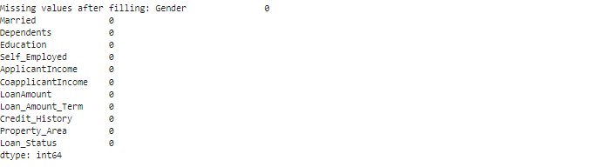
Data Wrangling
This is to check for any missing values in the dataset.
Output

Slide 13
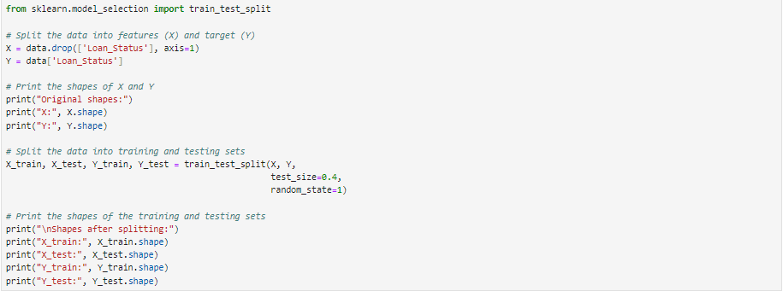
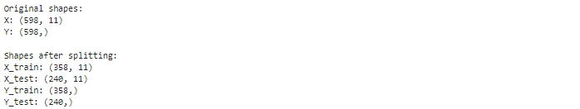
The dataset is split into features (X) and the target (Y), then further divided into training (60%) and testing (40%) sets. This ensures the model is trained on a portion of the data and evaluated on unseen data for better accuracy

Slide 14
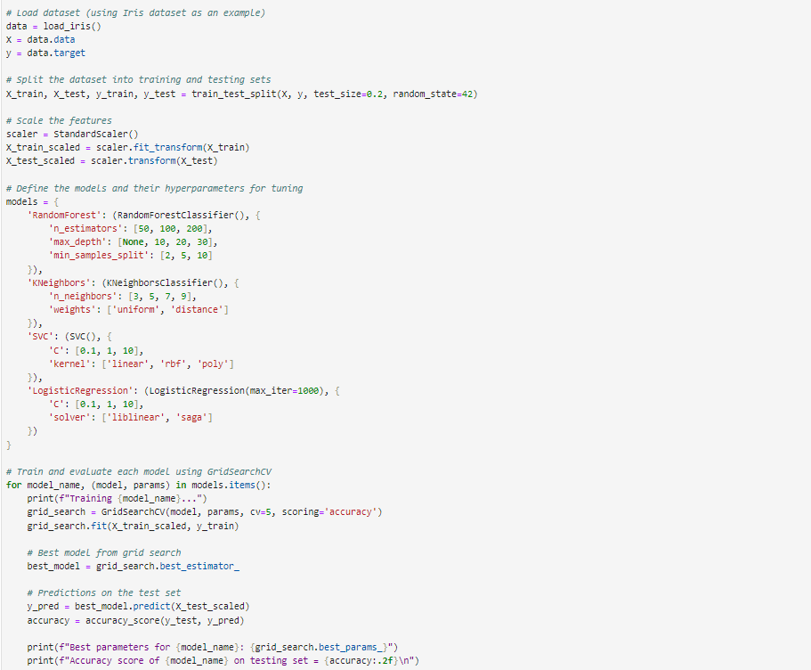
The dataset is split into training (80%) and testing (20%) sets, and features are scaled for consistency. Four models (RandomForest, KNeighbors, SVC, LogisticRegression) are trained using GridSearchCV to find the best hyperparameters. Each model is evaluated for accuracy on the test set, and the best parameters and accuracy score are printed for each model.

Slide 15
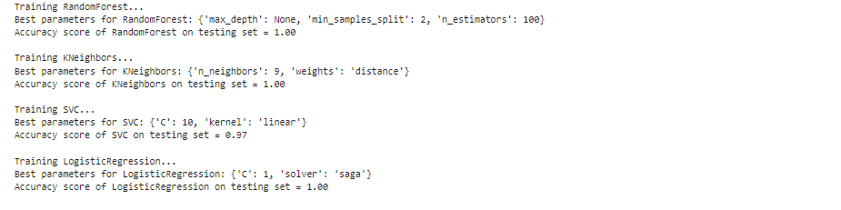
Output
The Random Forest, K Neighbors, and Logistic Regression models achieved a perfect accuracy of 1.00 on the test set. The SVC model had slightly lower accuracy at 0.97. Best hyperparameters for each model were identified through Grid SearchCV, optimizing their performance.

Slide 16
THE END

